Slide 1


MAHATMA GANDHI INSTITUTE OF TECHNOLOGY (A)
DEPARTMENT OF INFORMATION TECHNOLOGY
An Industry Oriented Mini Project (CB652PC)
on
RESUME CATEGORIZER
by
Y.S.S.K Keerthija -22261A3261
C.Shashank Reddy -22261A3211
Batch ID : CSB-25-06
Internal Supervisor IOMP Coordinator
Mrs.U.Chaitanya Dr. N.Sree Divya
Assistant Professor Assistant Professor

Slide 2
Abstract
Traditional resume screening methods are time-consuming, biased, and rely on rigid keyword matching, leading to inefficiencies in candidate selection.
Current ATS platforms are expensive, complex to implement, and struggle to adapt to evolving job market trends.
An automated resume categorization system leveraging machine learning, NLP, and TF-IDF to classify resumes into professional categories accurately.
The system employs supervised learning algorithms, NLP techniques, and open-source technologies for enhanced efficiency and adaptability.
Reduces manual effort, improves accuracy, supports batch processing, and provides structured, exportable outputs for large-scale hiring.
A cost-effective, user-friendly solution tailored for HR departments and recruitment agencies to streamline and optimize the hiring process.

Slide 3
Introduction
A smart automated system that helps HR teams and recruiters by automatically reading, analyzing, and categorizing resumes using machine learning technology, replacing the traditional manual screening process.
Existing: Traditional manual screening is time-consuming, inconsistent, and prone to human bias.
Proposed: Our automated system offers a fast, consistent, and unbiased approach, significantly improving the efficiency and accuracy of the recruitment process.
This innovative solution not only transforms how resumes are processed but also empowers HR teams to focus on strategic decision-making, ultimately leading to better hiring outcomes.
Automated Categorization: Automatically reads, analyzes, and categorizes resumes.
Text Analysis: Extracts key details using NLP.
Classification: Uses TF-IDF and Logistic Regression for categorization.
Results: Displays categorized resumes.

Slide 4
Existing System
Existing System
Current resume screening relies on manual review and basic keyword matching.
Traditional ATS platforms offer limited automation and lack intelligent analysis.
Key Aspects
Manual Processing: HR teams manually review resumes using spreadsheets and emails.
Basic ATS Solutions: Simple keyword searches with minimal categorization capabilities.
Keyword-Based Systems: Lacks contextual understanding, leading to inaccurate filtering.
Drawbacks/Limitations
Time-Consuming: Resume screening takes excessive hours, delaying hiring.
Inconsistent & Biased: Different reviewers interpret resumes differently.
Limited Scalability: Struggles to manage large application volumes.
Poor Accuracy: Misses qualified candidates due to rigid keyword matching.
High Costs: Manual efforts and inefficient ATS increase hiring expenses.

Slide 5
Proposed System
Proposed System
A resume categorization system that automates screening using ML, NLP, and a user-friendly Streamlit interface.
Key Aspects/Features
Intelligent Processing: Uses TF-IDF and Logistic Regression for deep resume analysis.
Automated Document Handling: Converts and extracts information from multiple file formats.
Real-Time Analysis: Provides instant results via an interactive dashboard.
Standardized Evaluation: Ensures fair, unbiased, and consistent resume assessment.
Smart Categorization: ML algorithms classify resumes into job roles.
Advantages
Improved Accuracy: ML ensures better candidate matching than keyword-based systems.
Cost-Effective: Reduces manual effort and hiring costs.
Scalable: Handles large applicant volumes with high efficiency.
Consistency: Eliminates human bias with standardized evaluation.
User-Friendly: Simple, intuitive interface for easy HR adoption.

Slide 6
Applications
Automated HR Processes: Streamlines resume sorting for HR teams.
Job Portals: Helps employers quickly filter and match candidates.
Recruitment Agencies: Speeds up candidate sorting for better engagement.
Educational Institutions: Guides students on suitable career paths.
Large Corporations: Manages high volumes of applications efficiently.
Overall, it enhances the efficiency and effectiveness of resume processing across multiple sectors.

Slide 7
Technical Specification
Software Requirements
Programming Language: Python 3.8+ (NLTK, scikit-learn, pandas, numpy)
Backend: Flask/FastAPI, RESTful APIs, ML models (TF-IDF, Logistic Regression)
Frontend: Streamlit, HTML5, CSS3.
Database: Kaggle (Resumes)
Development Environment: VS Code/Cursor, Jupyter Notebook
Operating System: Windows 11.
Hardware Requirements
Processor: Intel i3 (min), i5/i7 (recommended), multi-core (server)
GPU: Integrated (basic), NVIDIA GPU (optional, CUDA support)
RAM: 4GB (min), 8GB (recommended), 16GB+ (server)
Storage: 256GB HDD (min), 512GB SSD (recommended), 1TB+ (server)

Slide 8
Literature Survey
S.No | Author(s) & Title | Journal/ Conference | Year | Key Findings | Limitations
1. | T.K. Das, A.K. Tripathy, et al. “Machine Learning Approaches Towards Resume Classification” | International Journal of Computer Applications Technology and Research Volume 9, Issue 9 | 2022 | Explored various ML models for resume classification, analyzing their effectiveness and limitations. | No specific metrics mentioned; lacks validation on large datasets.
2. | Irfan Ali et al. “Resume Classification System Using NLP and ML Techniques” | ResearchGate Vol. 41, ISSN: 2413-7219 | 2022 | Developed a resume classification system using Natural Language Processing (NLP) and Machine Learning techniques for the recruitment process. | Domain coverage was limited; the model's generalization to multi-field resumes was not tested.
3. | S. K. Singh et al. “Machine Learning-Based Recommendations and Classification System for Resume Screening” | Revue d'Intelligence Artificielle Vol. 37, Iss. 3 | 2023 | Utilized NLP for resume data extraction and machine learning for classification and recommendations to support automated screening. | May require domain-specific training; not evaluated across diverse job sectors.

Slide 9
Problem Statement
The problem statement for the "Resume Categorizer Application" project is to address the inefficiencies and time-consuming nature of manually sorting and categorizing large volumes of resumes received by HR departments, recruitment agencies, and job portals. The goal is to develop an automated system that can accurately categorize resumes into predefined job categories using machine learning, thereby streamlining the recruitment process, improving candidate-job matching, and providing valuable insights into application trends.

Slide 10
Objectives
1. Automated Resume Classification
Automated the categorization of resumes, significantly reducing the time and effort required for manual screening.
Enabled recruiters to focus more on candidate engagement and strategic hiring decisions.
2. Enhanced Processing Speed
Achieved resume categorization within seconds per document, drastically cutting down the wait time.
Improved recruiter workflow efficiency by enabling near-instantaneous sorting of large resume batches.
3. High Volume Handling
Developed a scalable system capable of processing over multiple resumes.
Ensured the platform is suitable for mass recruitment drives and enterprise-level hiring demands.
4. Improved Matching Accuracy
Enhanced the precision of candidate-to-job matching, leading to higher quality shortlists and better alignment with role requirements.
Reduced the chances of skill-role mismatch, leading to better interview-to-offer conversion rates.

Slide 11
Objectives
5. Strengthened Domain Generalization
Successfully categorized resumes from over different industries, including IT, Finance, Healthcare, and Education.
Overcame the domain-restriction issues faced by earlier models, making the system highly adaptable.
6. Ensured System Scalability and Reliability
Ensured continuous system performance and minimal downtime even under high-volume resume processing conditions.
Guaranteed consistent performance and minimized downtime during critical recruitment periods.

Slide 12
Modules Description
File Upload Module Function: Manages the uploading of PDF resumes via the Streamlit interface. Key Role: Ensures that users can submit resumes in PDF format for processing.
PDF Processing Module Function: Extracts text from uploaded PDFs using the PdfReader library. Key Role: Converts the content of the PDF resumes into machine-readable text for further processing.
Text Cleaning Module Function: Preprocesses the extracted text, using regular expressions to clean up unwanted elements (e.g., extra spaces, headers, footers). Key Role: Ensures the text is clean and ready for feature extraction.
Feature Transformation Module Function: Converts the cleaned text into numerical features using a TF-IDF vectorizer. Key Role: Transforms the resume data into a format suitable for machine learning models.

Slide 13
Modules Description
Prediction Module Function: Uses a pre-trained machine learning model to predict the job category of each resume based on the transformed features. Key Role: Classifies resumes into predefined job categories.
Category Mapping Module Function: Maps the predicted category ID to a human-readable job category name. Key Role: Ensures that users see a user-friendly job category instead of raw numerical predictions.
File Organization Module Function: Organizes and saves the categorized resumes into directories according to their predicted job category. Key Role: Helps maintain an organized system where resumes are saved based on their respective categories for easy access.
Result Compilation Module Function: Compiles the categorization results into a DataFrame for display and download. Key Role: Allows users to view the categorization results and download them for further use.

Slide 14
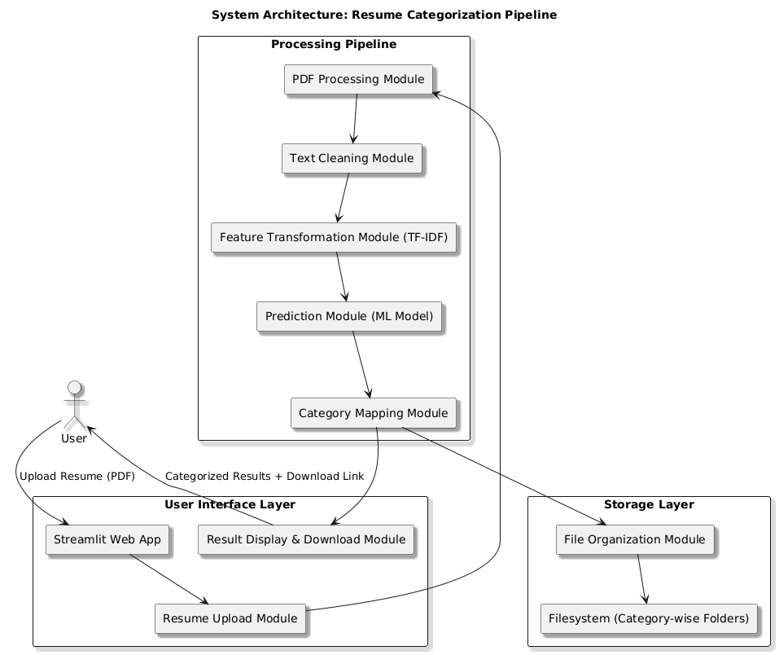
System Architecture Diagram

Slide 15
Algorithm
1. TF-IDF (Term Frequency – Inverse Document Frequency)
Purpose: To convert resume text into meaningful numerical features that can be processed by a machine learning model.
Algorithm Explanation: TF-IDF measures how important a word is in a particular document (resume) compared to all other documents in the dataset.
Term Frequency (TF): Measures how frequently a word appears in a resume.
Inverse Document Frequency (IDF): Measures how rare or unique a word is across all resumes.
Words that are frequent in one resume but uncommon in others are given higher importance. This helps the model focus on keywords that matter most for classification.
2. Label Encoding ( Technique )
Purpose: To convert textual job category labels into numeric values so that machine learning algorithms can process them.
Algorithm Explanation: Label Encoding assigns a unique integer to each job category.
For example:
HR → 0
Data Scientist → 1
Web Developer → 2
These numeric labels are then used as targets during model training and prediction.

Slide 16
Algorithm
3. Logistic Regression
Purpose: To classify resumes into the appropriate job category based on their content.
Algorithm Explanation: Logistic Regression is a supervised learning algorithm used for classification tasks. It analyzes the relationship between input features (from TF-IDF) and output labels (job categories) to calculate the probability of each category.
The model selects the category with the highest probability. Although the name includes "regression(prediction)", the algorithm is mainly used for classification problems.
Why Use Logistic Regression?
It’s fast and works well when the relationship between input and output is roughly linear.
It gives a probability score, not just a hard label.
Works well for binary and multi-class classification.

Slide 17
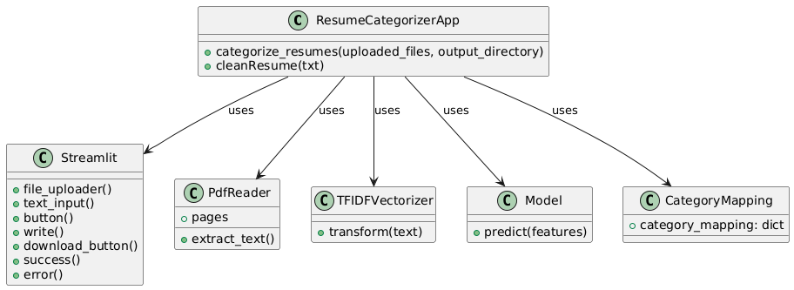
Design: UML Diagrams
Fig 1: Class Diagram

Slide 18
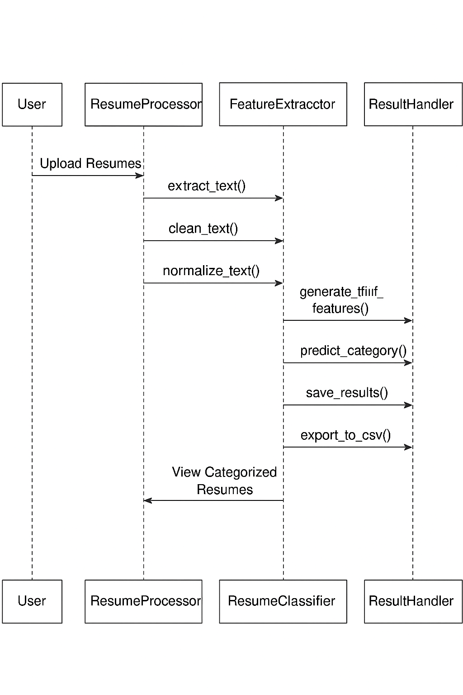
Design : UML Diagrams
Fig 2: Sequential Flow Diagram

Slide 19
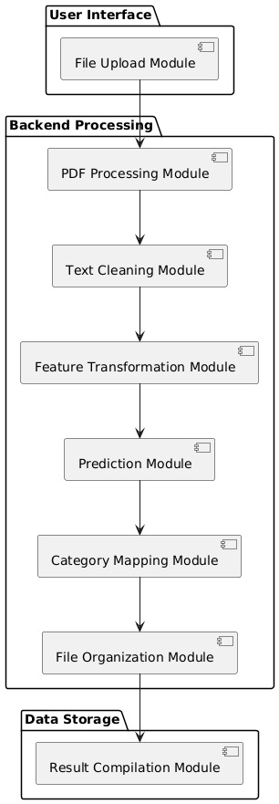
Design : UML Diagrams
Fig 3: Activity Diagram

Slide 20
Proposed Methodology
Step 1: Data Preprocessing
Objective: Convert resume text into numerical features. Process:
Extract text content from uploaded resume PDFs.
Clean the text by removing special characters, stopwords, and irrelevant content.
Apply TF-IDF (Term Frequency – Inverse Document Frequency) to transform cleaned text into feature vectors.
TF-IDF emphasizes domain-specific terms by assigning higher importance to rare but relevant words.
This helps the model focus on meaningful keywords for accurate classification.
Step 2: Label Transformation
Objective: Convert job category labels into machine-readable form. Process:
Use Label Encoding to map each job category (e.g., “HR”, “Data Scientist”, “Web Developer”) to a unique numeric value.
This enables supervised learning models to process and learn from labeled resume data efficiently.

Slide 21
Proposed Methodology
Step 3: Classification Model
Objective: Train a predictive model for resume categorization. Process:
Utilize Logistic Regression as the primary classification algorithm.
It calculates the probability of each resume belonging to different job categories.
The category with the highest probability is selected as the prediction.
Logistic Regression was chosen for its speed, interpretability, and strong performance in text-based classification tasks.

Slide 22
Proposed Methodology
Project Objective | Methodology Contribution
Automated Classification | TF-IDF + Logistic Regression classify resumes without manual effort.
Enhanced Processing Speed | Lightweight model ensures results within seconds.
High Volume Handling | Scalable design supports batch resume uploads.
Improved Matching Accuracy | TF-IDF captures domain terms; Logistic Regression ensures precision.
Cross-Domain Generalization | Model adapts to resumes from IT, Finance, Healthcare, etc.
System Scalability & Reliability | Efficient architecture ensures smooth performance even under heavy load.

Slide 23
Proposed Methodology
Packages used
os: Provides operating system-dependent functionality like checking and creating directories.
pandas (pd): Used for data manipulation and analysis, specifically to create a DataFrame of categorization results.
pickle: Used for serializing and deserializing Python objects, including loading the pre-trained model and vectorizer.
pypdf (PdfReader): Extracts text from PDF resumes for processing and categorization.
re: Utilized for cleaning resume text by removing unwanted characters and patterns using regular expressions.
streamlit (st): Builds the user interface, allowing users to upload resumes, specify directories, and view categorization results.
Formulas Used
1. TF-IDF (Term Frequency-Inverse Document Frequency)
TF-IDF(t,d)=TF(t,d)×IDF(t)
Where:
TF(t, d) = (Number of times term t appears in document d) ÷ (Total number of terms in document d)
IDF(t)=log(Total Number of documents/Number of documents containing term t)

Slide 24

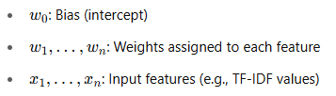

Proposed Methodology
Formulas Used
2. Logistic Regression:
Linear combination:
Sigmoid function (binary classification):
What it means:
Takes the output z from the linear combination
Squashes it into a value between 0 and 1
This value is interpreted as the probability of belonging to the "positive" class (e.g., spam vs. not spam)
If σ(z)>0.5: Predict class 1 If σ(z)<0.5: Predict class 0
Why sigmoid? It’s smooth, differentiable, and maps any real number to a probability.

Slide 25

Proposed Methodology
Softmax function (multi-class classification):
What it means:
Suppose you have K classes (e.g., cat, dog, horse)
Each class gets a score from a linear combination
The softmax turns those scores into probabilities that sum to 1
It answers: “What is the probability that this input belongs to class i?”
Why softmax? It lets the model pick one class out of many by comparing how strong each class’s score is.
Component | Purpose
Linear Combination | Compute raw score from inputs and weights
Sigmoid | Turn raw score into probability (2 classes)
Softmax | Turn multiple scores into probabilities (multi-class)

Slide 26
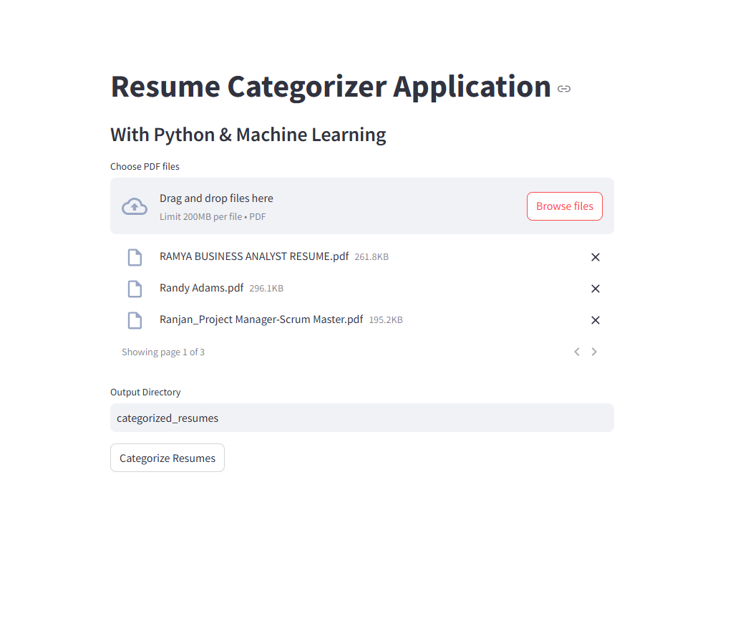
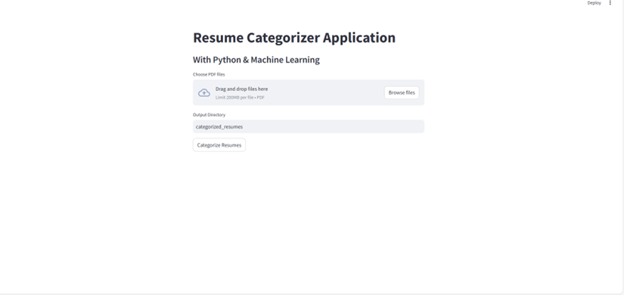
Results
Fig. Initial page
Fig. Input page

Slide 27
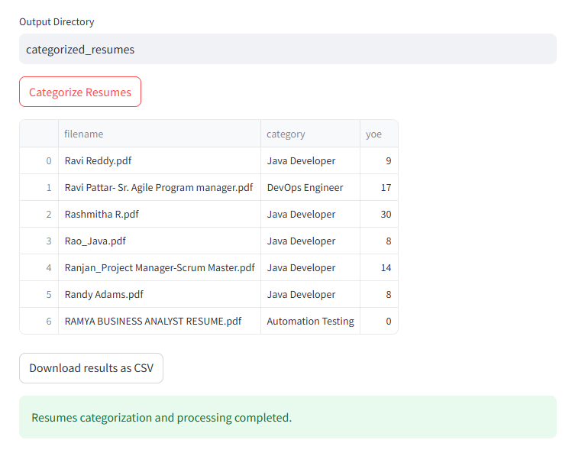
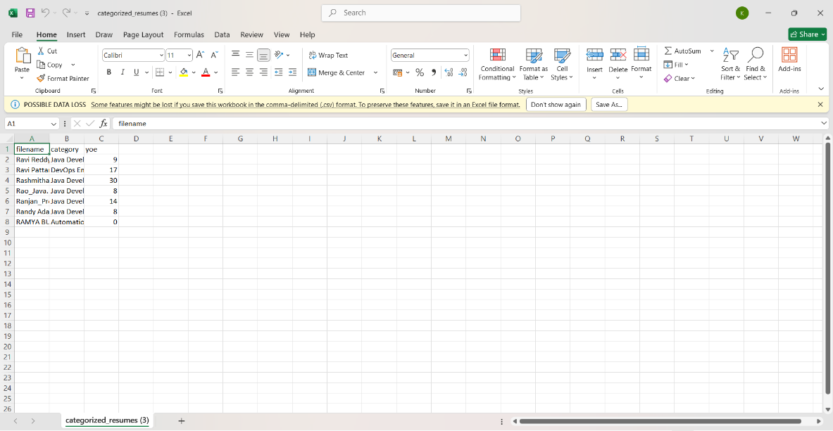
Results
Fig. Categorization page
Fig. Exported CSV File

Slide 28
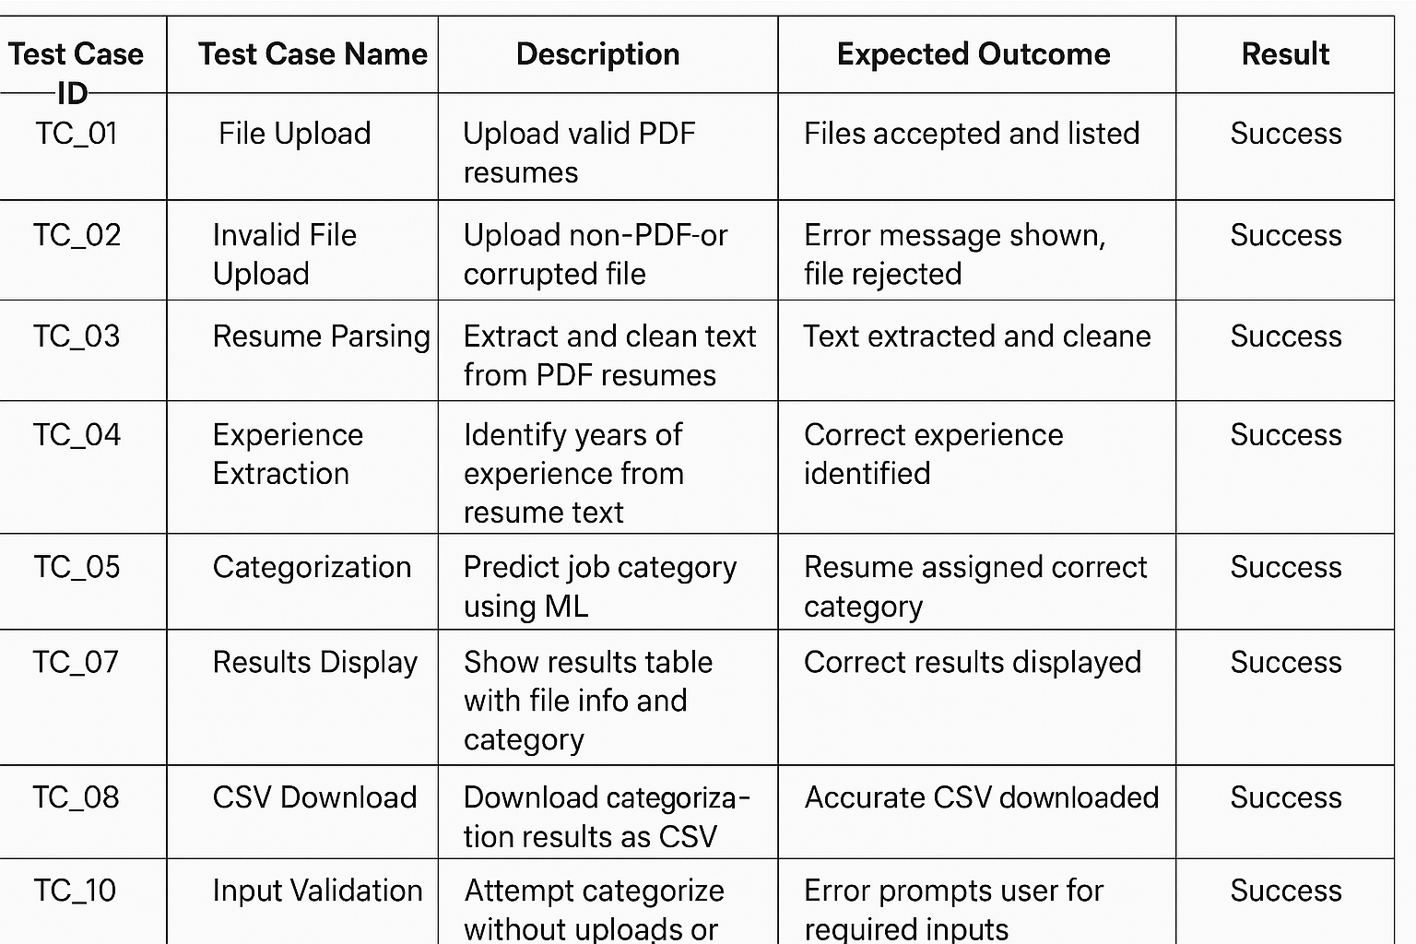
Testcases

Slide 29
Conclusion & Future Enhancements
Conclusion: The Resume Categorization Application effectively combines machine learning and NLP to automate resume classification, improving recruitment efficiency. Using TF-IDF and Logistic Regression, it ensures accurate categorization, reduces manual effort, and minimizes bias. The Streamlit interface offers ease of use, while modular design supports scalability and data privacy.
Future Enhancements:
Support additional file formats (DOCX, TXT, RTF)
Advanced skill extraction via NER and deep learning
Candidate ranking based on job relevance
Integration with job portals and HR systems
User authentication and role-based access
Interactive analytics dashboard with visual insights
Multilingual support and translation
Cloud deployment for scalability and collaboration
Recruiter feedback loop for model improvement
Automated email notifications for status updates

Slide 30
References
Malhotra et al., Automated Resume Screening using NLP & ML, Procedia CS, 2020
Saha et al., Automated Resume Classification, SMART Conference, 2021
Saha et al., Resume Classification and Ranking, ComPE, 2020
Saha et al., Resume Screening using Text Mining, ICACCI, 2018
Kaur & Sood, Intelligent Resume Shortlisting, IJIM Data Insights, 2021
Saha et al., Survey on Resume Screening Systems, IJACSA, 2019
Saha et al., NLP for Resume Screening: A Review, JIOS, 2022

Slide 31
THANK YOU

